Slide 1
Why Is My Classifier Discriminatory?
Yijun Liu
Department of Computer Science
University of Wyoming
Chen I , Johansson F D , Sontag D . Why Is My Classifier Discriminatory?[J]. 2018.

Slide 2
Introduction
Background
Sources of perceived discrimination
Reducing discrimination through data collection
Experiments

Slide 3
Introduction
As machine learning algorithms increasingly affect decision making in society, many have raised concerns about the fairness and biases of these algorithms
Recent attempts to achieve fairness in predictive models focus on the balance between fairness and accuracy.
In sensitive applications such as healthcare or criminal justice, this trade-off is often undesirable as any increase in prediction error could have devastating consequences.

Slide 4




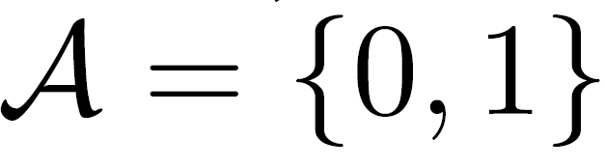
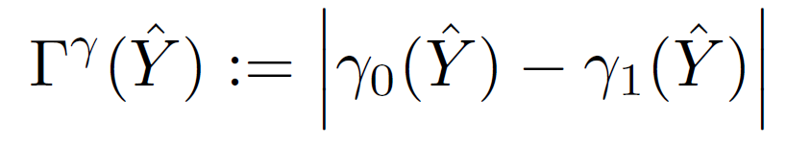

Background
We study fairness in prediction of an outcome a protected attribute
Predictions are based on a set of covariates
Predictions learned from a training set d are denoted The protected attribute is assumed to be binary
We define FPR and FNR with respect to protected group：
to define the level of discrimination： 􀀀
mean-squared error
Satisfy equalized odds if

Slide 5
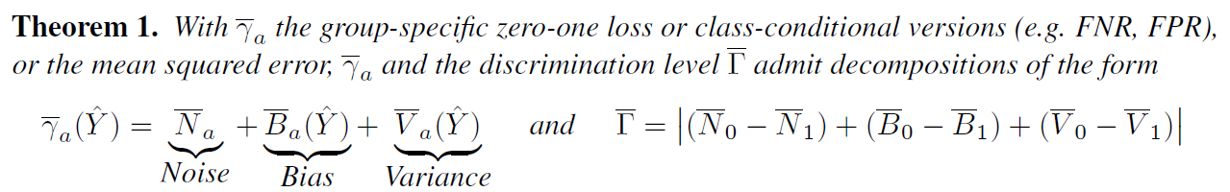
Sources of perceived discrimination
Following Domingos (2000),

Slide 6
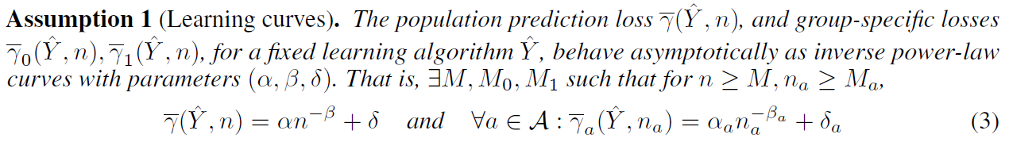
Reducing discrimination through data collection
Empirically, learning curves behave asymptotically as inverse power-law curves for diverse algorithms such as deep neural networks, support vector machines, and nearest-neighbor classifiers

Slide 7

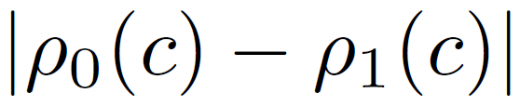
Measuring additional variables
Let a random variable C represent a (possibly stochastic) clustering such that C = c indicates membership in cluster c. Then let ρ_{a}(c) denote the expected prediction cost for units in cluster c with protected attribute a. As an example, for the zero-one loss we let
Clusters c for which is large identify groups of individuals for which discrimination is worse than average, and can guide targeted collection of additional variables or samples.

Slide 8
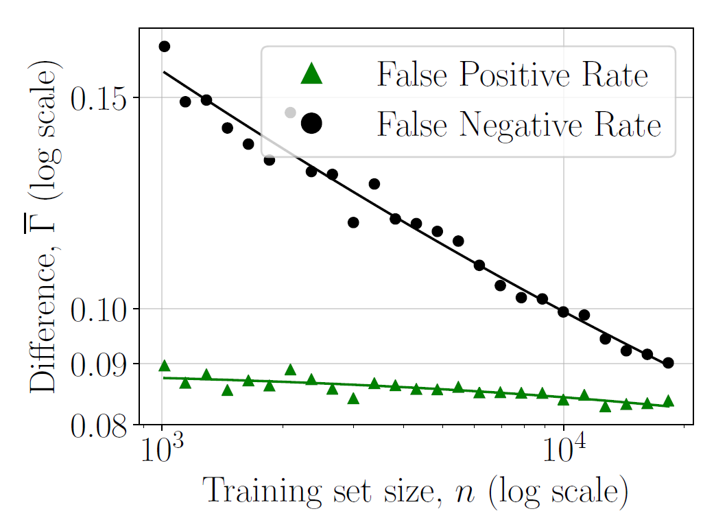
Experiments (Income prediction)
The Adult dataset in the UCI Machine Learning Repository (Lichman, 2013) contains
32,561 observations of yearly income and twelve categorical or continuous features including education, age, and marital status.
Group differences in false positive rates and false negative rates for a random forest classifier decrease with increasing training set size.

Slide 9
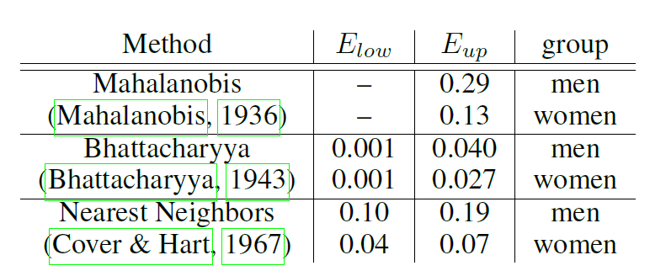
Experiments (Income prediction)
we compare estimated upper and lower bounds on noise (E_{low} and E_{up}) for men and women using the Mahalanobis and Bhattacharyya distances, and a k-nearest neighbor method.
For nearest neighbors estimates, intervals for men and women are non-overlapping, which suggests that noise may contribute substantially to discrimination.

